Slide 1
Girls into Coding activity 3 images

Slide 2
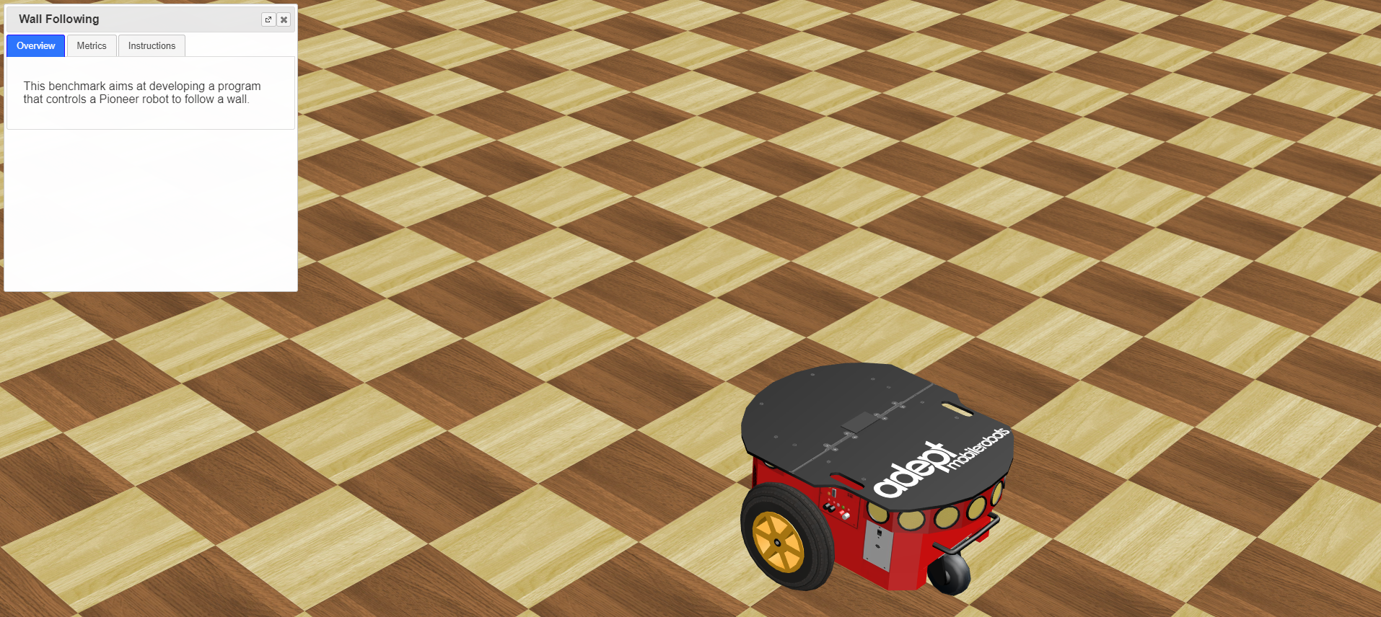
Image 1
We can close these instructions for the moment, we won’t use them yet for this activity! We will take a look at them later on ☺!
This is our robot ! ☺
These yellow spots are the robot’s ultrasonic distance sensors!!

Slide 3
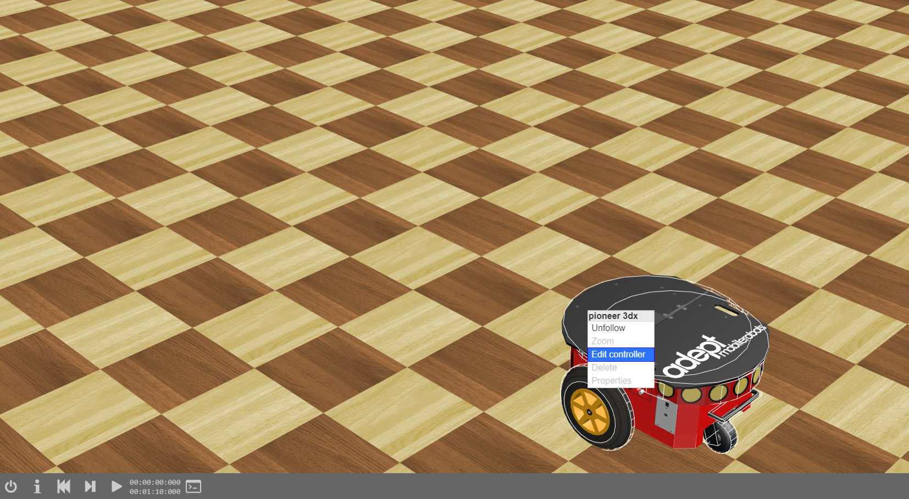
Image 2
[1] Right click on the robot
[2] Click: Edit controller

Slide 4
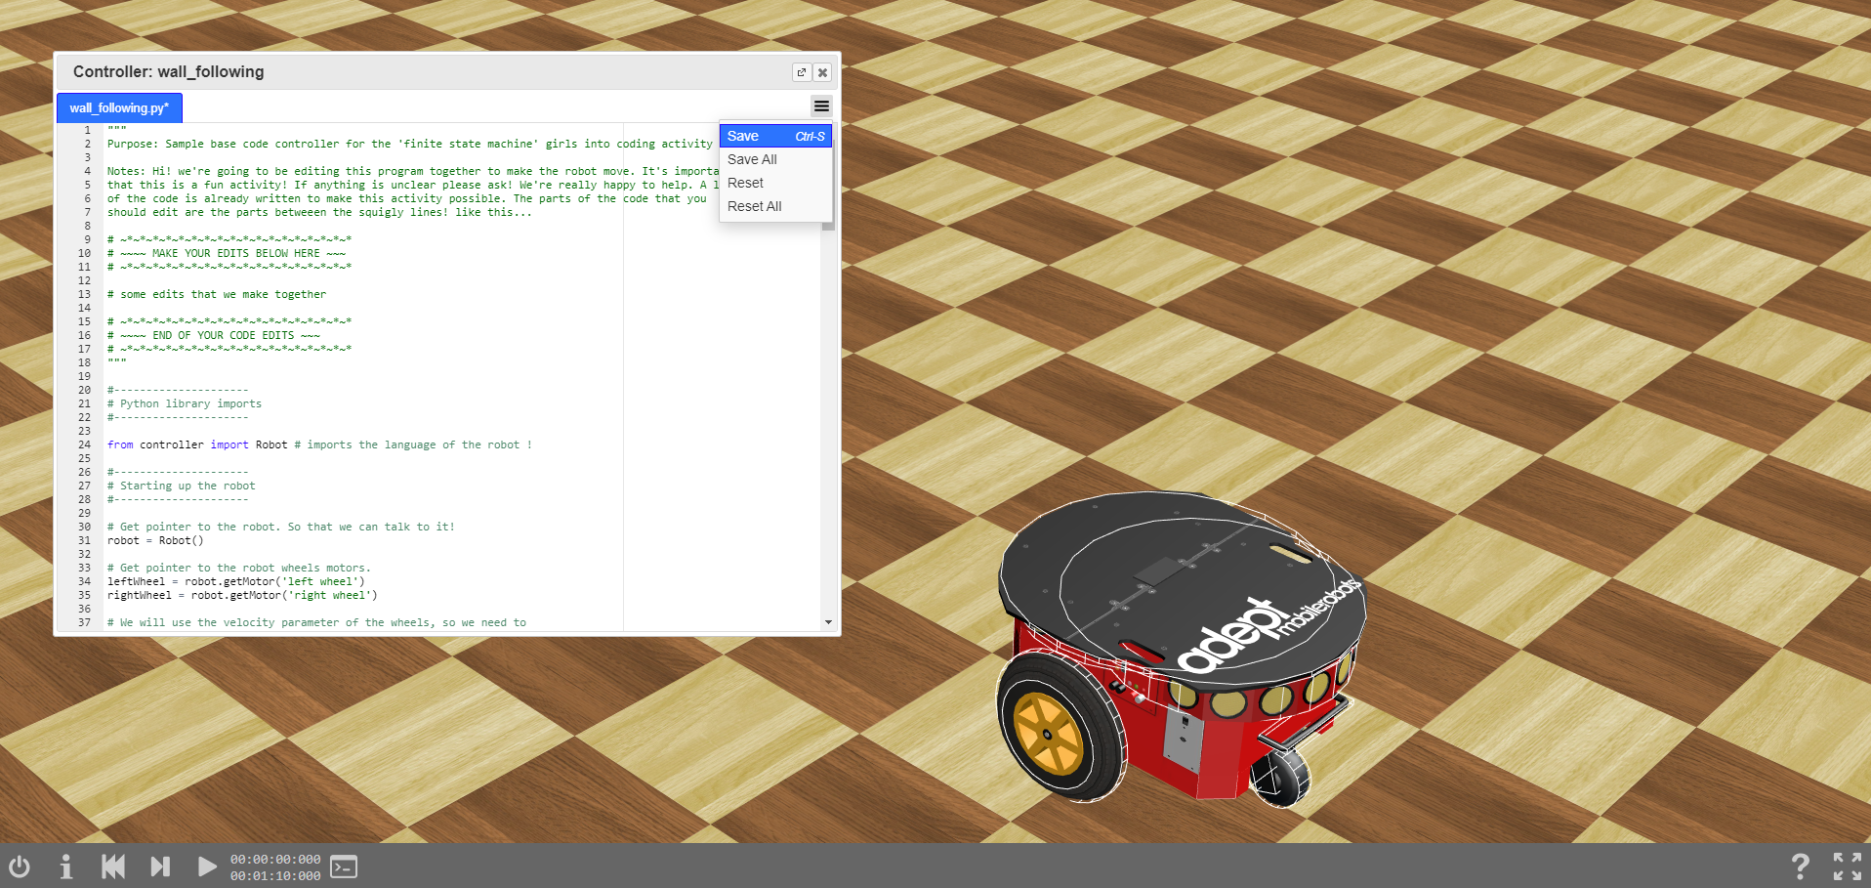
Image 3
[1] We should end up with the new code pasted in the controller window
[2] Click the menu icon, then -> Save
[3] Reset simulation
[4] Start simulation

Slide 5
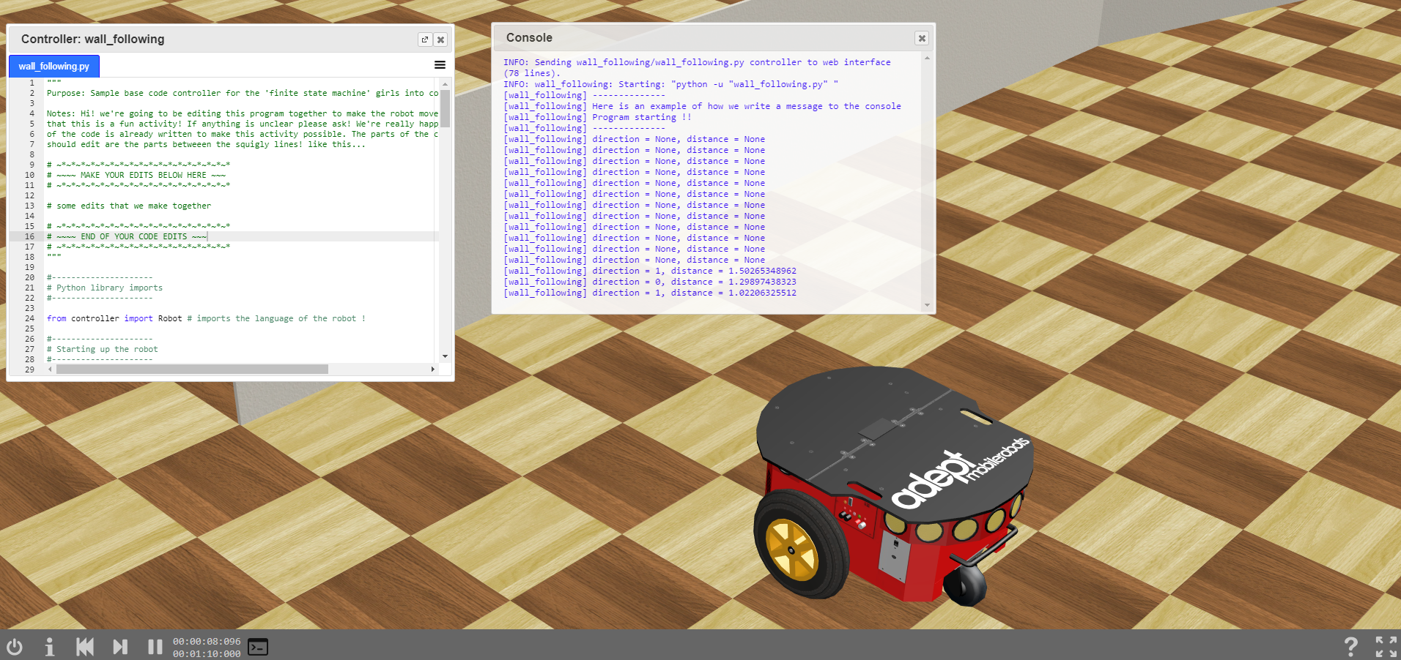
Image 5
[2] We should see this window pop up! We can see our messages from the robot here
[5] Have a look at how the messages change as the robot approaches the wall!
[3] Reset the simulation
[4] Start the simulation
[1] Click console

Slide 6
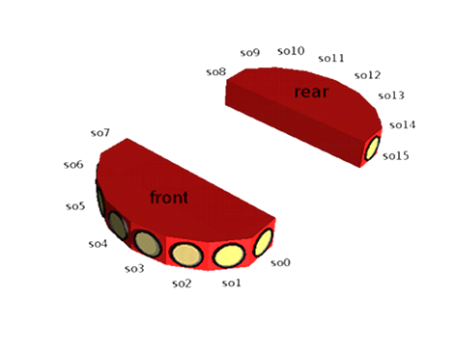
Image 6
How we measure object location using the ultrasonic sensors!
3.5
2.5
1.5
Right
Direction
0
Distance (meters)
0.5
0.5
1
Left
1.5
-3.5
-0.5
-2.5
-1.5

Slide 7
Image 7
Our finite state machine ☺ !
It’s not complicated once we talk about it !
0
Key
Start
Go forwards
No object detected
Robot state number
State
name
Transition condition
Object detected
2 seconds passed
Less than 2 seconds passed
Go Backwards
Less than 2 seconds passed
Turn right
2 seconds passed
1
2

Slide 8
Image 8
Our pseudo code for a state machine ☺ !
It’s not complicated once we talk about it !
Never ending loop
Loop forever!
Switcher(robotState):
If robotState == 0:
goForwards()
If robotState == 1:
goBackwards()
If robotState == 2:
turnRight()
Transition conditions in functions
If wall detected then:
robotState =1
If backwards movement finished then:
robotState =2
If turn movement finished then:
robotState =0

